Slide 2
Inclusive Trade Through Online Presence
Emmanuel Orkoh1
Robert Teh2
1 Nordic Africa Institute & Northwest University
2 Independent Researcher
Uppsala 20191223

Slide 3
Outline
Outline
Introduction and main questions
Data and some stylized facts
Methodology
Results and discussions
Conclusions

Slide 4
Inclusive Trade
Inclusiveness in trade has become important due to increasing backlash against globalization recent years.
Numerous leaders and international organizations emphasize "inclusiveness in trade" as a key aspect of economic policy, often linking it with equitable access and shared benefits in global commerce.
To preserve public support for freer trade, it is not enough to pursue policies that promote efficiency in resource allocation, but also more equitable access.

Slide 5
Digitalization
Advances in information and communication technology (ICT) have allowed an expansion of international trade (Freund and Weinhold (2004), Hortaçsu et al (2009), Lendle et al (2016)):
reduced trade costs,
Efficiency in logistics
Improved custom procedures
Reduced enforcement cost
. Doubling internet usage in 151 countries contributes to 2%-4% increase in service trade(Choi, 2010)
Access to the internet increases firms exported share of sales by 32%-36% in developing countries (Timmis, 2013)
High-speed internet connections or websites induces 6%-10% likelihood of firms’ participation in global value chains (Gopalan, Reddy & Sasidharan, 2022)

Slide 6
Digitalization
Beyond its associated efficiency gains, can digitalization also enhance the “inclusiveness” of trade?
Can online presence help the following type of firms enter export markets and sell more?
  Small and medium-sized enterprises
  Firms owned or managed by women or where the majority of workers are females
  Firms from low-income countries and developing regions of the world
  Service sector firms.

Slide 7
Data
We use the World Bank Enterprise surveys (July 2022)
More than 180,000 firms in 154 countries
Information collected between 2006 to 2021
Data collected include among others:
Characteristics: country, sector, firm size, online presence, ownership, management, employees
Firm performance: sales, exports, imports, capital utilization, innovation
Business environment: infrastructure, regulatory environment, trade facilitation

Slide 8
Stylized Facts
Exporting firms are different from non-exporting firms
Observable differences:
Larger in size, innovative, pay higher wages, more capital intensive
Unobservable differences:
Managerial competence and vision, organizational culture, employee skill sets, knowledge and networks, innovative capacity, risk tolerance etc.

Slide 9
Exporting firms are different from non-exporters

Slide 10
Exporting firms are different from non-exporters
Item | Share of foreign inputs (%) | Foreign ownership share (%) | Managerial experience (Years) | Years established (Years)
Below median | 14.9 | 16.5 | 15.1 | 23.5
Above median | 34.4 | 42.4 | 23.8 | 14.5

Slide 11
Industry and country factors

Slide 12
Methodology
Selection model with endogenous binary variable in both selection and outcome equations
Outcome variable is the firm’s level of exports which depends on online presence (a binary variable) and other explanatory variables
Selection into exporting depends on online presence, other covariates and exclusion variable not appearing in outcome equation
Online presence is assumed to be endogenous

Slide 13
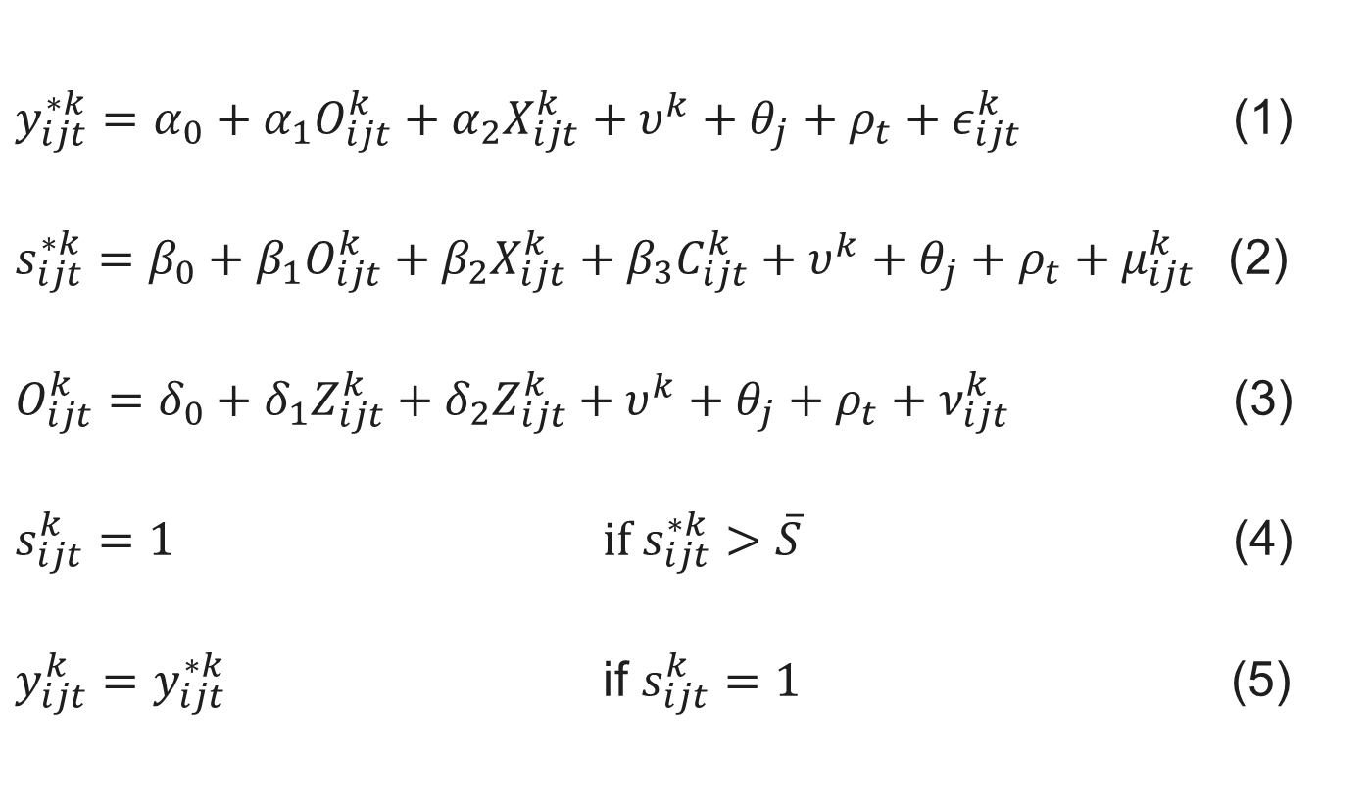
Model
$y_{ijt}^{∗k}=α_{0}+α_{1}O_{ijt}^{k}+α_{2}X_{ijt}^{k}+υ^{k}+θ_{j}+ρ_{t}+ε_{ijt}^{k}$ (1)
$s_{ijt}^{∗k}=β_{0}+β_{1}O_{ijt}^{k}+β_{2}X_{ijt}^{k}+β_{3}C_{ijt}^{k}+υ^{k}+θ_{j}+ρ_{t}+μ_{ijt}^{k}$(2)
$O_{ijt}^{k}=δ_{0}+δ_{1}Z_{ijt}^{k}+δ_{2}Z_{ijt}^{k}+υ^{k}+θ_{j}+ρ_{t}+ν_{ijt}^{k}$ (3)
$s_{ijt}^{k}=1$ $if s_{ijt}^{∗k}>\overline{S}$ (4)
$y_{ijt}^{k}=$ $y_{ijt}^{∗k}$ if $s_{ijt}^{k}=1$ (5)

Slide 14
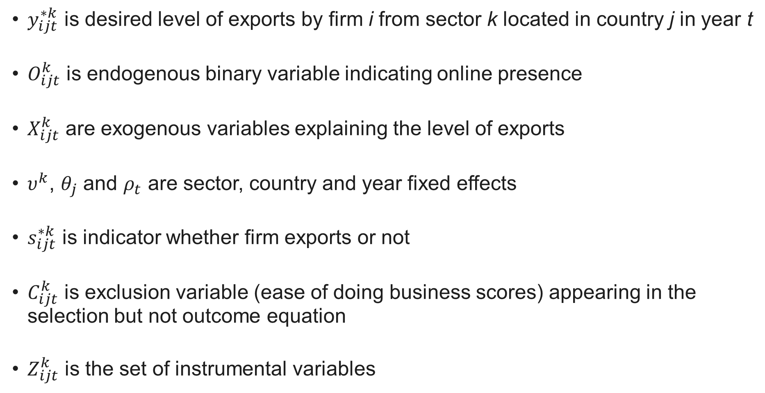
Variables
$y_{ijt}^{∗k}$ is desired level of exports by firm i from sector k located in country j in year t
$O_{ijt}^{k}$ is endogenous binary variable indicating online presence
$X_{ijt}^{k}$ are exogenous variables explaining the level of exports
$υ^{k}$, $θ_{j}$ and $ρ_{t}$ are sector, country and year fixed effects
$s_{ijt}^{∗k}$ is indicator whether firm exports or not
$C_{ijt}^{k}$ is exclusion variable (ease of doing business scores) appearing in the selection but not outcome equation
$Z_{ijt}^{k}$ is the set of instrumental variables

Slide 15
Variables
Online presence
Female top manager
Firm size (small, medium & large)
Innovation (new process)
Foreign ownership
Managerial experience
Year established
Share of imported inputs
Instrument for selection equation
Fixed broad band subscription (per 100 people)
Mobile cellelur subscriptions (per 100 people)
Individuals using the internet (% of population)
 | Total | Yes (%) | No (%) | Missing (%)
Website | 185,879 | 49.3 | 47.2 | 3.5
Email | 185,879 | 52.0 | 21.1 | 27.0
Broadband | 185,879 | 17.1 | 6.4 | 76.5
Internet | 185,879 | 9.3 | 0.02 | 90.6
Online | 185,879 | 69.8 | 27.1 | 3.1

Slide 16
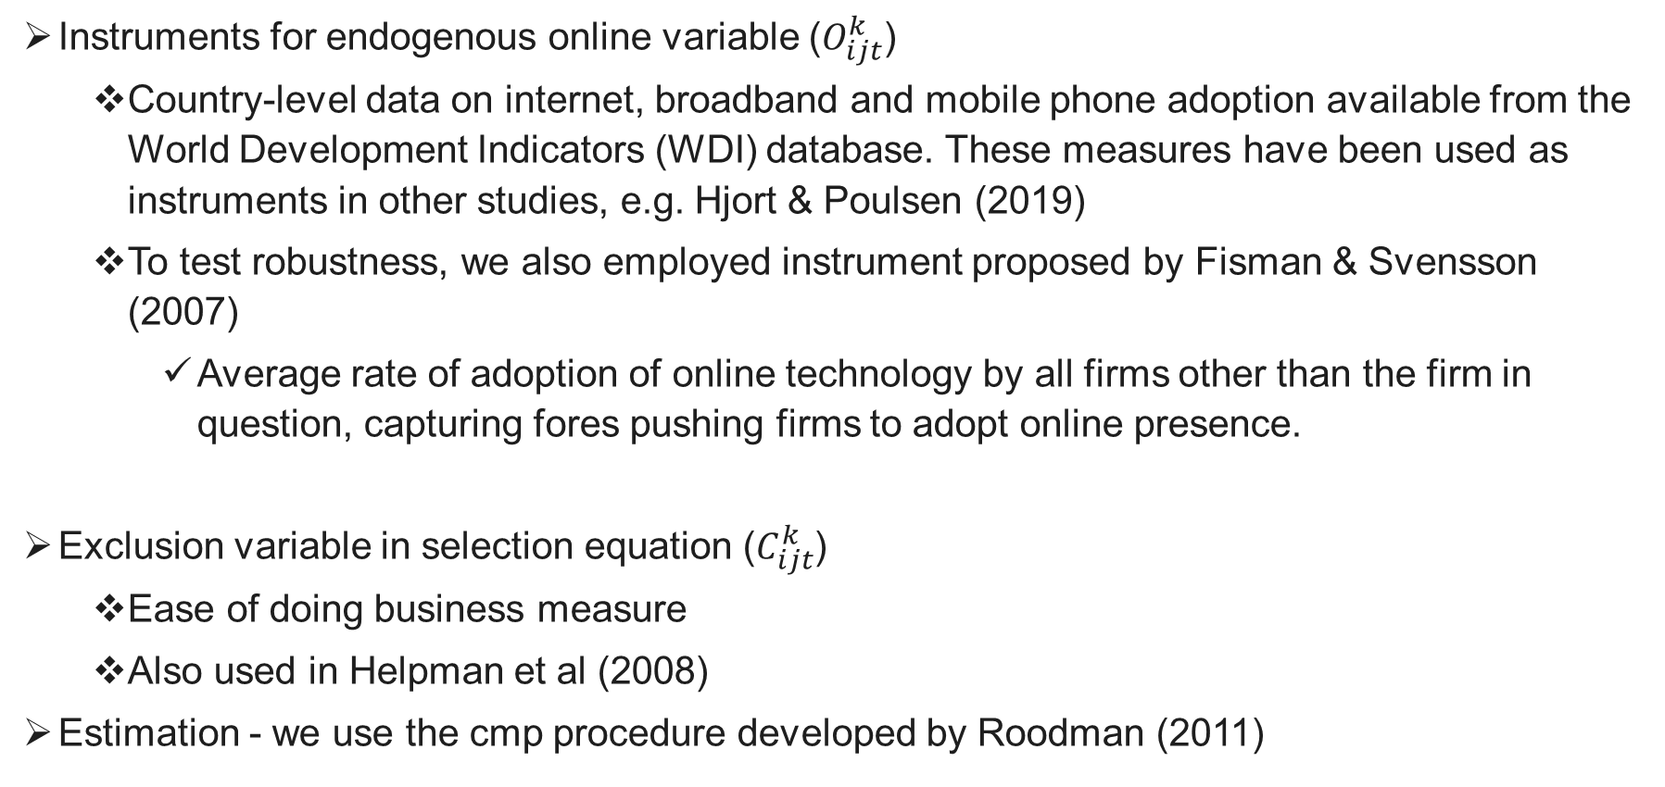
Estimation issues
Instruments for endogenous online variable ($O_{ijt}^{k}$)
  Country-level data on internet, broadband and mobile phone adoption available from the World Development Indicators (WDI) database. These measures have been used as instruments in other studies, e.g. Hjort & Poulsen (2019)
  To test robustness, we also employed instrument proposed by Fisman & Svensson (2007)
    Average rate of adoption of online technology by all firms other than the firm in question, capturing fores pushing firms to adopt online presence.
Exclusion variable in selection equation ($C_{ijt}^{k}$)
  Ease of doing business measure
  Also used in Helpman et al (2008)
Estimation - we use the cmp procedure developed by Roodman (2011)

Slide 17
Baseline results

Slide 18
Main estimation results
Impact of online presence on probability of exporting
  Probability of exporting increases by 8 percentage points
Impact of online presence on level of exports
  Increase in level of exports of around 37%

Slide 19
Defining inclusiveness of online presence
Weak form
Online presence increases the probability of exporting and level of export of firms which have historically struggled to trade
Strong form
Eg. SMEs which have an online presence are more likely to export and have higher level of exports than SMEs without an online presence
Online presence increases the probability of exporting of firms which have historically struggled to trade more so than firms which have not historically struggled to trade
Eg. SMEs which have an online presence enhances the export chances and level of export of SMEs more than larger firms

Slide 20
Low and middle-income countries
Low-income countries
Online presence increases the probability of exporting of firms from low-income countries more than those of firms from other income groups
Low and middle-income countries
Online presence increases the level of exports of firms from low and middle-income countries more than firms from high-income countries

Slide 21
Developing and developed regions
Entry to export markets
Online presence increases the probability of exporting of firms from Latin America & Caribbean, Middle East & North Africa and South Asia more than firms from other regions
Level of exports
Online presence increases the level of exports of firms from Africa and Latin America & Caribbean more than those from other regions

Slide 22
Small and medium-sized enterprises
Most SMES are not exporters
As we observed in the survey data, only a small proportion of SMEs export
Entry to export markets
Online presence increases the probability that SMEs are able to enter foreign markets
Level of exports
Online presence increases the level of SMEs’ exports

Slide 23
Women and trade
Entry to export markets
Online presence increases the probability that firms majority-owned by women, or whose top manager is female, or with a majority females workforce are able to enter foreign markets
Level of exports
Online presence increases the level of exports of majority-owned by women, or whose top manager is female

Slide 24
Services firms
High trade cost for services firms
As we observed in the survey data, only a small proportion of SMEs export
Entry to export markets
Online presence increases the probability that SMEs are able to enter foreign markets
Level of exports
Online presence increases the level of SMEs’ exports

Slide 25
Conclusions
Promoting efficiency through trade opening is not enough; it is also necessary to design them with inclusiveness in mind
Increasing online presence of firms particularly in poor countries is one way to achieve both goals
Policies:
Greater public as well as private investment in ICT infrastructure
Establishment of the appropriate legal and regulatory environment
Targeted interventions addressing specific constituencies (e.g. SMEs and women)
Trade facilitation
International cooperation (e.g. through the WTO)

